Slide 1
Your Life Story

Slide 2
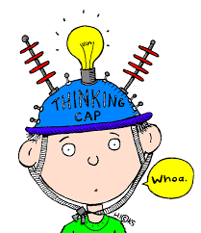
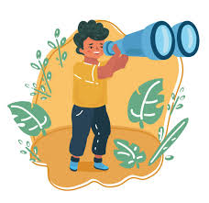
Life Story
Everyone has a story about their life, and how they came to live where they do now.
Your Life Story Worker – the person reading this to you – meets with lots of children and their parents.
Their job is to help children know their life story:
like what, where, when, who and why things happened.
Together we will think about these things, to help you find your story.
This can help you now and in your future….

Slide 3
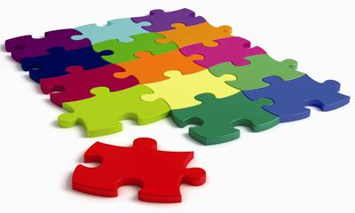
Once we start
Your Life Story Worker will talk to the people who knew you before you lived where you do now, to find out about your life.
Some people may have a different story, but that’s okay, because everyone is different and will have different things they remember.
A bit like detectives, we will look at all the stories and piece them together, like a jigsaw, so you can find your own story.

Slide 4
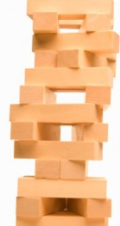
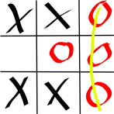
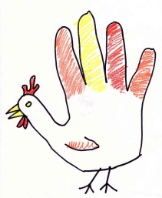
When we meet
First, we will play some games so we can get to know each other before we start your Life Story.
We will meet every other week; you, me and …, usually on the same day at the same time.
We will start to think about all the feelings we have and how we can talk about them.
To help tell your story we will use wallpaper; to draw and write on with pens and stickers. Each time we meet we can roll out the wallpaper and then roll it away at the end for you to look after it until the next time.

Slide 5
Your Life Story Book
As we get towards the end of our work together we will make a book with your drawings and thoughts from the wallpaper.
Our Life Story carries on as we grow up and live our lives. You will have many choices in your life and I hope this work will help you make good choices so you can have the life you would like.
As you grow up, your book can help you remember things about you. You can choose if you show it to other people who you might want to know about you and your life.

Slide 6
Any questions???
Here you can write or draw any questions you have about doing Life Story Work

